Slide 1

2018 California QSO Party

Slide 2

California QSO Party
CQP is considered to be one of the largest (and best!) State QSO Party contests
>900 logs >300,000 QSOs
Lots of awards including
48 Wooden Plaques
20 Bottles of Wine
Club Competition
YL Awards
Youth Award
New Contester Award (California)
Participation Certificates
Cool T-Shirt
Most legal fun on the air !!!

Slide 3
Rules - Simplified
Starts: 1600z on 6 Oct 2018 (Sat morning)
Ends: 2200z on 7 Oct 2018 (Sun afternoon)
3 points for each CW QSO
2 points for each phone QSO
Score = total points x multipliers (58 max)
Multipliers = States/Canadian Provinces
Work anyone, once per band-mode
Bands: 160, 80, 40, 20, 15, and 10 meters
Modes: CW, SSB

Slide 4
How To QSO
EXCHANGE 1. California stations send QSO number and 4-letter county abbreviation. 2. Stations outside of California send QSO number and 2-letter State, Canadian area abbreviation, or "DX".
Step 1. California station AD6E calls CQ
CQ CQP AD6E AD6E CQ
CQ CQP AD6E AD6E CQ
W1AW calls him
Step 2. AD6E sends W1AW 123 SFRA (= serial #123, SF County)
Step 3. W1AW then sends AD6E 52 CT (= serial #52, Connecticut)
Step 4. AD6E continues TU QRZ CQP AD6E

Slide 5
What Band / When ?
9am
4pm
8pm
40 m
7am
20 m
1am
80 m
20 m
15 m

Slide 6
Multiple Ways to Play
Single Op
Single Op Assisted
Multi-Single
Multi-Multi
Mobile
Expedition
School
QRP
Club competition

Slide 7
New Club Competition Rules
Club Competition in the California QSO Party has been supported for many years, but traditionally only a handful of larger clubs in California tend to compete each year. To encourage more small-medium club participation, we’ve created three new competition categories:
"Small" = the 10 highest scores from a club whose members who submitted their log in the Small category will count for this competition category.
"Medium" = the 35 highest scores from a club whose members who submitted their log in the Medium category will count for this competition category.
"Large" = clubs may combine the scores of any number of their members
All ARRL-affiliated or RAC-affiliated clubs are eligible to compete in CQP, except for NCCC, which sponsors the contest.
Plaques will be awarded for each of the 3 categories (i.e., Small, Medium, Large) for both California and Non-California clubs: a total of 6 awards.

Slide 8
Other Hints
Know the MULT names:
4 characters for CA counties
2 characters for States, VE
http://www.cqp.org/cqp_multipliers.html
Know your phonetics for phone
Use Logging software
keeps track of dupes
keeps track of mults
keeps track of score
output Cabrillo log format
http://www.cqp.org/software.html

Slide 9
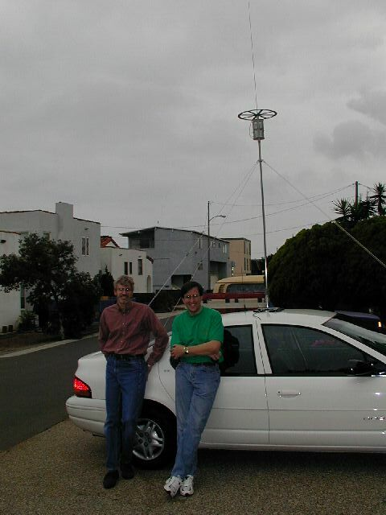
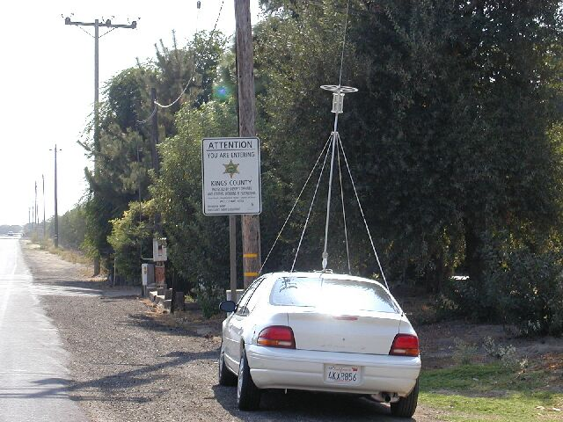
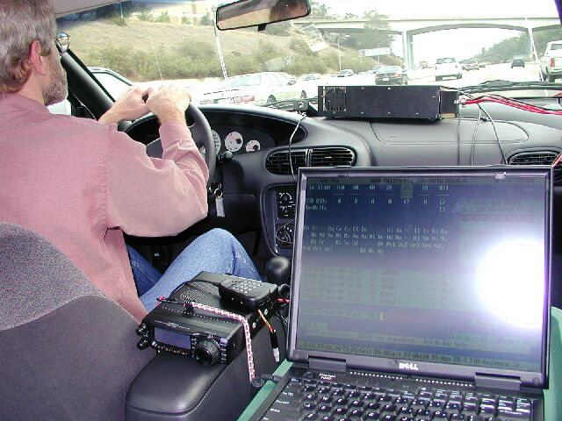
Mobile

Slide 10
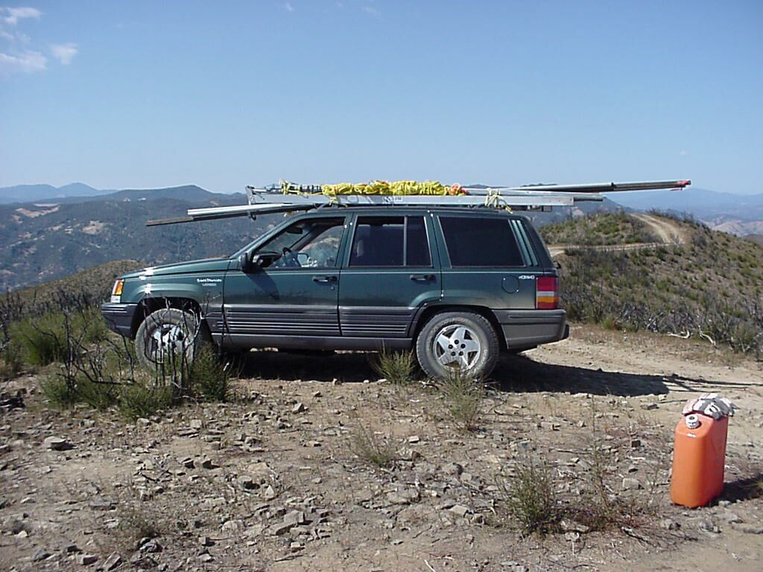
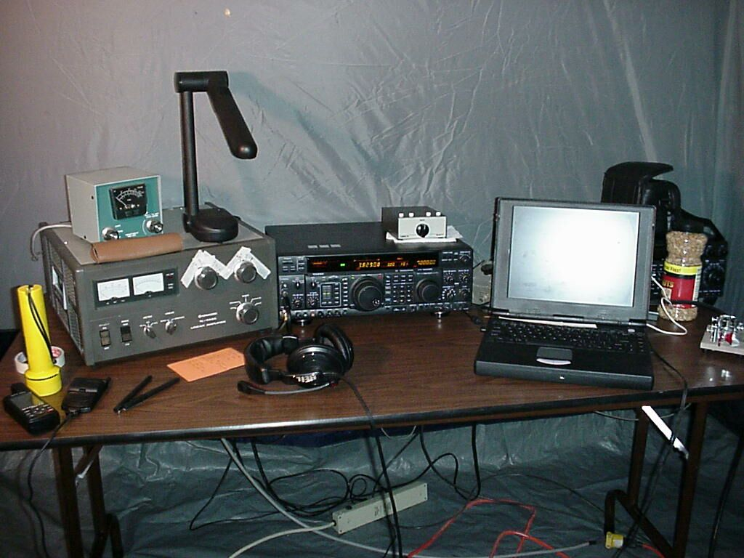
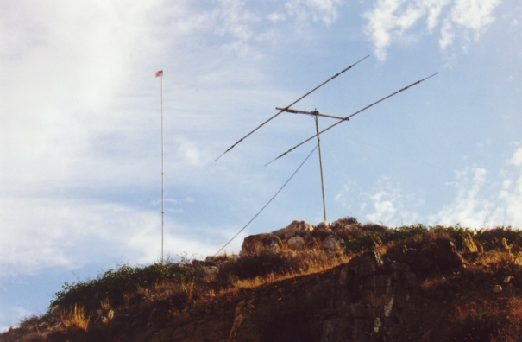
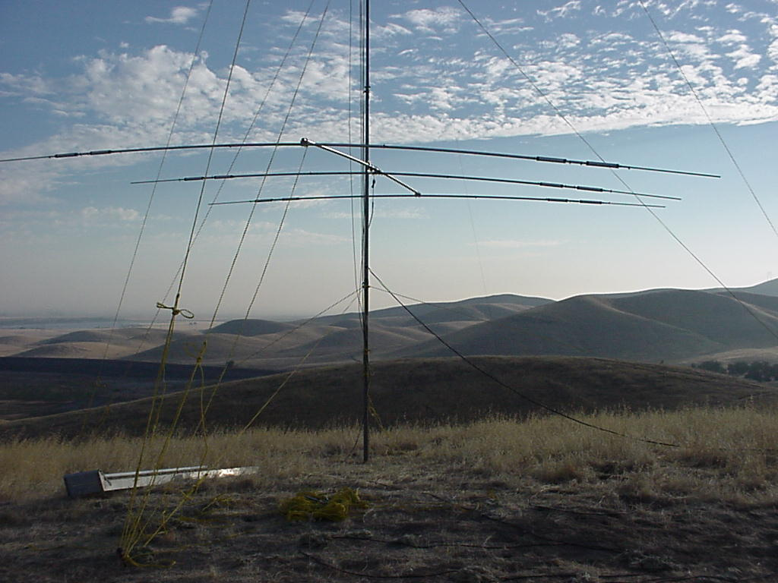
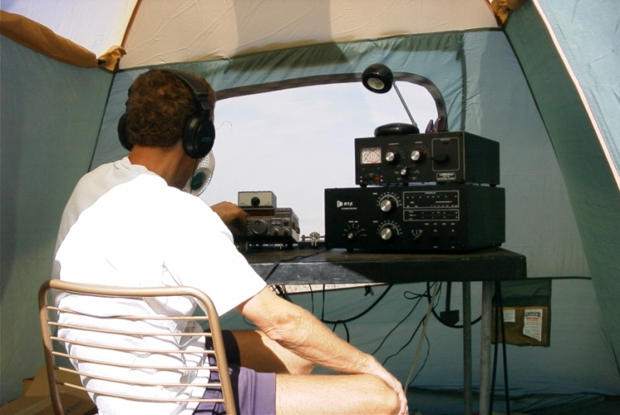
Expedition – Field Day Style
N7CW - IMP

Slide 11
The California QSO Party 2017
Starts: October 6, 2018 1600 UTC
Ends: October 7, 2018 2200 UTC
After The Contest, Send In Your Log! Log submission deadline: 23:59 UTC MONDAY, OCTOBER 22, 2018
Complete Rules: http://cqp.org
Have FUN in the CQP!!!

Slide 12
CQP is sponsored by: The Northern California Contest Club
Nationally recognized as a top-tier amateur radio contest club.
Devoted to the pursuit of operating and technical excellence in amateur radio contesting.
Experience the fun, satisfaction, and competitive thrill of radio contesting.
World class operators
Monthly meetings
Websites:
NCCC: http://nccc.cc
CQP: http://cqp.org

